Slide 1
Getting insights
from your datasets
Section 16
Notes:
[Mandatory Slide] This would be the introduction slide of the topic that you are covering in this section.
When this slide plays, you could talk about the main aim that we’d be covering in this section.

Slide 2
What We’ll Learn
Building a cryptocurrency prices dataset
Better visualizations for crypto prices
Calculating moving averages of crypto prices
Revealing trends in crypto market
Building a comprehensive dataset is the first step for good data exploration
Japanese Candlestick plots are compact visualizations for prices. MACD is an oscillator that can be used to trigger buy and sell signals
Moving Averages help to identify macro price trends by dropping random price fluctuations
Let’s calculate how cryptocurrency close prices correlate over time and test a portfolio composition

Slide 3
Building a cryptocurrency
prices dataset
Notes:
[Mandatory Slide] This would be the introduction slide of the topic that you are covering in this subsection.
When this slide plays, you could talk about the main aim that we’d be covering in this video.

Slide 4
In this Video, we are going to take a look at…
Datasources for cryptocurrency data
Code: building the crypto dataset
Notes:
[Mandatory Slide]
Before the start of the video, we’d like to highlight what are important topics or pointers that we’d be covering in this video. This slide would immediately follow the intro/name slide. This would just be say 2-3 points for the viewers to know what they are getting into.

Slide 5
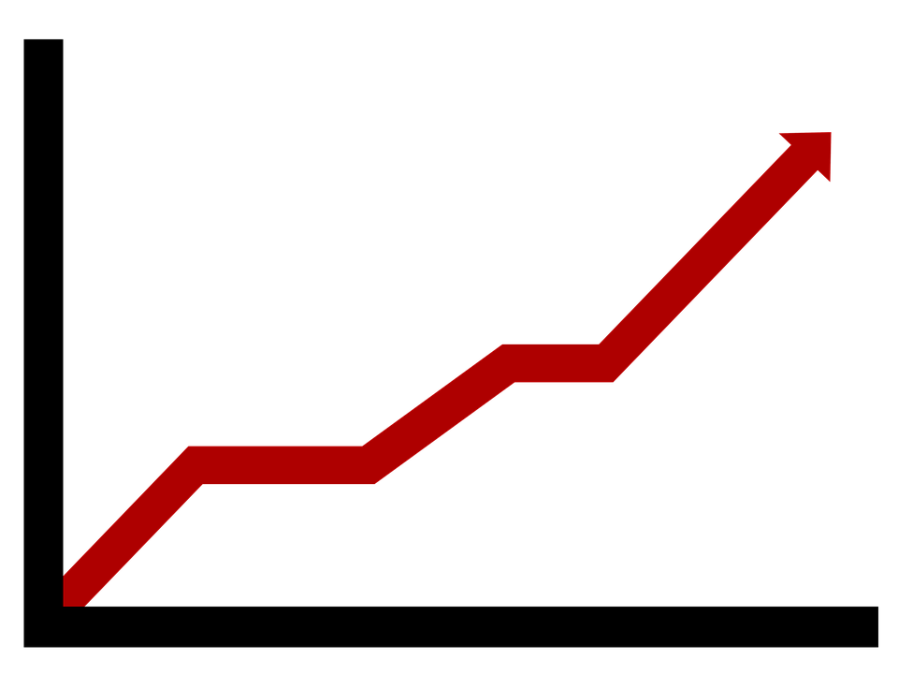

Datasources for cryptocurrency data
Let’s build a CSV dataset about crypto coins
The dataset shall
refer to at least 10 crypto coins
refer to a fixed time-range of at least 6 months
have at least daily OLHC (Open Low High Close) prices
A few considerations:
Coins data should possibly come from the same cryptocurrency exchange
Non-mainstream coins are usually traded against Bitcoin. This means that we will probably need to convert their OLCH prices to a selected fiat currency such as USD once we retrieve the daily BTC-USD exchange data
Notes:
[Mandatory Slide]
Before the start of the video, we’d like to highlight what are important topics or pointers that we’d be covering in this video. This slide would immediately follow the intro/name slide. This would just be say 2-3 points for the viewers to know what they are getting into.

Slide 6
Datasources for cryptocurrency data (2/2)
Upon this dataset we will:
calculate and plot Simple Moving Averages and Exponential Moving Averages
calculate and plot Moving Average Convergence/Divergence (MACD) oscillator
calculate and plot candlestick representations
calculate and plot correlation matrix among crypto coins
Again, this won’t teach you how get rich with trading! You will only be shown how to apply basic tools and techniques of the so called “technical analysis” of stock markets (of which I’m not an expert at all)
Notes:
[Mandatory Slide]
Before the start of the video, we’d like to highlight what are important topics or pointers that we’d be covering in this video. This slide would immediately follow the intro/name slide. This would just be say 2-3 points for the viewers to know what they are getting into.

Slide 7
Code Sample: building the crypto dataset
Notes:
Something that needs to grab the viewers attention!!

Slide 8
Summary
Datasources for cryptocurrency data
Code Sample: building the crypto dataset
Notes:
[Mandatory Slide]
Before the start of the video, we’d like to highlight what are important topics or pointers that we’d be covering in this video. This slide would immediately follow the intro/name slide. This would just be say 2-3 points for the viewers to know what they are getting into.

Slide 9
Calculating moving averages of crypto prices
Next Video
Notes:
[Mandatory Slide]
Here the name of the next video needs to be mentioned. The narration as you guessed it would be just letting the viewer know exactly where we are at and what we’d be taking over next! ☺

